Slide 1
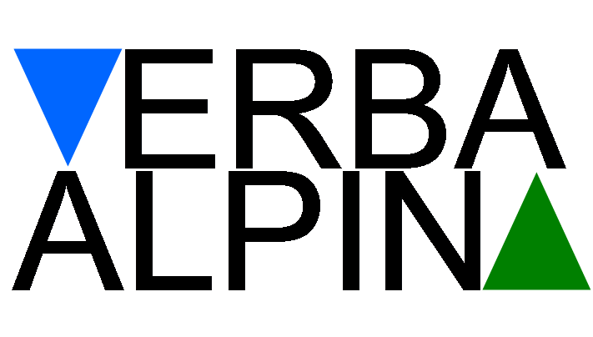
The Virtual Research Environment of VerbaAlpina and its Lexicographic Function
http://www.verba-alpina.gwi.uni-muenchen.de
18th Euralex International Congress, 17-21 July 2018, Ljubljana

Slide 2

The Virtual Research Environment of VerbaAlpina and its Lexicographic Function
Outline
1) Project description
- area under investigation
- data and methodology
2) Lexicographic function
- transcription (analogue/digital data)
- tokenization
- typification
- data access (interactive map/database)

Slide 3
The Virtual Research Environment of VerbaAlpina and its Lexicographic Function
3) Approaches to sustainability
- versioning
- citability
- long-term archiving

Slide 4
The Virtual Research Environment of VerbaAlpina and its Lexicographic Function
1) Project description
VerbaAlpina. Der alpine Kulturraum im Spiegel seiner Mehrsprachigkeit (VerbaAlpina. The Alpine cultural region reflected through its multilingualism)
Funded by the German Research Foundation (DFG)
1st term: 10/2014-10/2017, 2nd term: 11/2017-11/2020 (perspective until 2025)
Investigation of the multilingual Alpine region
Combination of (geo-)linguistics and digital humanities
Notes:
- VA seeks to investigate the linguistic and cultural area of the entire Alpine region from a transnational perspective through selective analyses

Slide 5
The Virtual Research Environment of VerbaAlpina and its Lexicographic Function
Area under investigation: The Alpine region
Area of investigation is limited to the territorial borders defined by the Alpine convention
surface area of 190,600 km², encompasses parts of six different countries (D, A, CH, I, F, SLO) and two entire countries (FL, MC)
Notes:
Alpine convention: The Alpine Convention is an international treaty between the Alpine Countries (Austria, France, Germany, Italy, Liechtenstein, Monaco, Slovenia and Switzerland) as well as the EU, for the sustainable development and protection of the Alps.
- This area covers a surface area of 190,600 km²

Slide 6
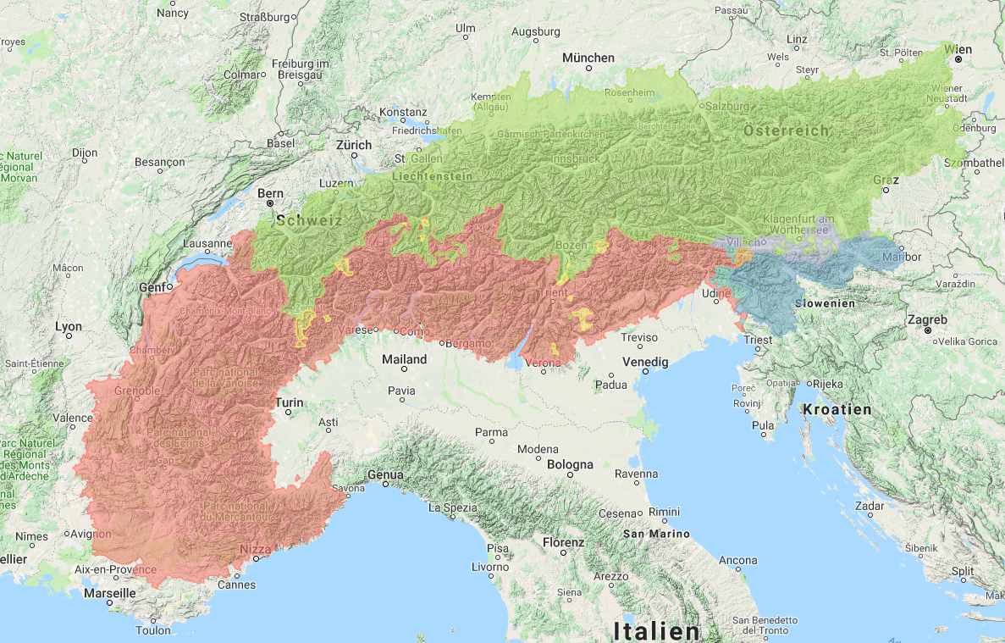
The Virtual Research Environment of VerbaAlpina and its Lexicographic Function
ethnographic and topographic homogeneity and strong linguistic heterogeneity → 3 language families (Germanic, Romance and Slavonic)
Germanic
Slavonic
Romance
Notes:
The Alpine region is characterised by …
This linguistic heterogeneity, which includes three large language families (Germanic, Romance and Slavonic), has made the region a topic of interest for linguists
- Accordingly: VerbaAlpina focuses on the following languages and their respective dialects: German, French, Italian, Slovenian, Franco-Provençal, Romansh, Ladin, Friulian and Occitan.

Slide 7
The Virtual Research Environment of VerbaAlpina and its Lexicographic Function
Three conceptual domains
project years
1 | 2 | 3 | 4 | 5 | 6 | 7 | 8 | 9
calendar year
2014 | 2015 | 2016 | 2017 | 2018 | 2019 | 2020 | 2021 | 2022 | 2023
i, ii, iii, iv | i, ii, iii, iv | i, ii, iii, iv | i, ii, iii, iv | i, ii, iii, iv | i, ii, iii, iv | i, ii, iii, iv | i, ii, iii, iv | i, ii, iii, iv | i, ii, iii, iv
quarter
project phase
I | II | III
culture milk processing | nature landscape formations weather fauna flora | modern life ecology tourism
focus
alpine pasture farming
Notes:
VerbaAlpina investigates the Alpine lexis of three conceptual domains, one in each project phase
- Stage one focused on vocabulary related to…, in the current phase the project is concerned with the lexis of the domains…., the last stage will focus on…
- Second project phase: the data collection of vocabulary regarding the first project phase is not finished yet, in each project phase there is only added another vocabulary section which will be investigated

Slide 8
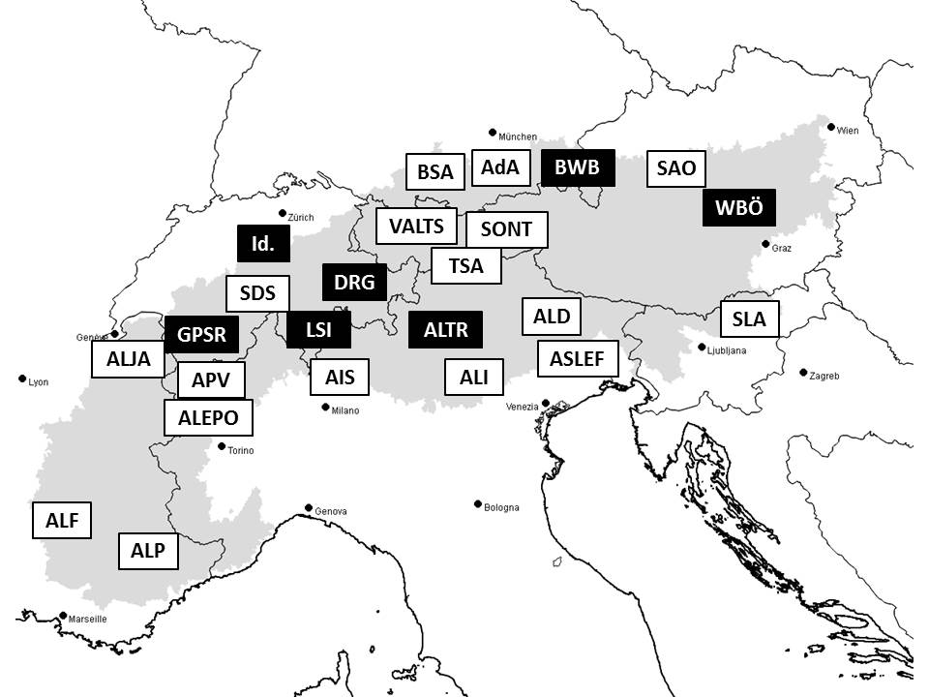
The Virtual Research Environment of VerbaAlpina and its Lexicographic Function
Data and methodology
Collection and analysis of data from linguistic atlases and from geo-referenced dictionaries from the past one hundred years
Notes:
Figure: gives an overview of the large number of traditional atlases and lexica in which the relevant vocabulary of the Alpine region is recorded
- Yet these resources lack a multilingual perspective and only cover parts of the Alpine vocabulary. They were created at different times and document diverse concepts

Slide 9
The Virtual Research Environment of VerbaAlpina and its Lexicographic Function
Data and methodology
Online-Crowdsourcing: to even out, complete and correct
inhomogenous data stock
→ Combination of three different approaches of digital geolinguistics:
- digitally published atlases (data gathered through traditional methods, e.g. ALD)
- atlases which document diverse languages and language families (e.g. WALS)
- web-based atlases (e.g. AdA)
Notes:
- atlases which are digitally published but whose data has been gathered through traditional methods (e.g. ALD)
- atlases which document diverse languages and language families (e.g. WALS)
- web-based atlases which use the internet to create data sets (e.g. AdA)

Slide 10
The Virtual Research Environment of VerbaAlpina and its Lexicographic Function
Data and methodology
- challenge:
lack of uniformity of data from individual data sources
unification of the different transcription systems
process of systematic data processing:
        - Transcription
        - Tokenization
        - Typification
Notes:
VA addresses the major challenge posed by the lack of uniformity of the data from the individual data sources (linguistic atlases, dictionaries, crowdsourcing) → are not structured in the same way
VerbaAlpina must first unify the different transcription systems of the atlases and dictionaries
For this purpose, the already existing data in both digital and analogue form undergo a process of systematic data processing to fit the unified structure of the relational database (MySQL) in which all project data is stored
→ These sub-processes will be described in more detail by my colleague
This process can be subdivided into three major steps: transcription, tokenisation and typification.

Slide 11
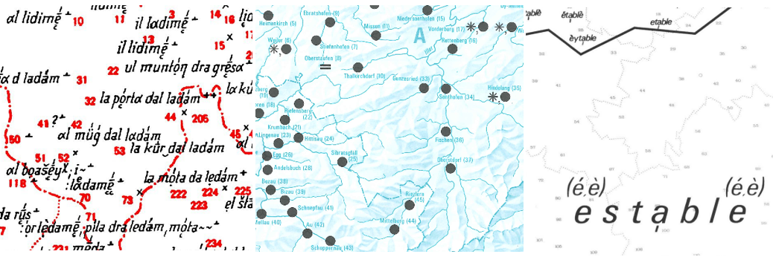
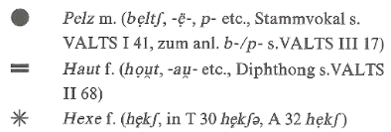
The Virtual Research Environment of VerbaAlpina and its Lexicographic Function
Lexicographic Process
Transcription / Transfer
Tokenization
Typification
Data Access
&
Visualization
Different conception of the source (Transcription Tool)
Different transcription systems (BetaCode -> IPA)
Different codification – for every source individual solutions
Splitting utterances into single tokens
Dividing grammatical from lexical information
Converting into IPA using unique codepage for every source
Labelling POS, language family, gender, affix, base type, reference
Allocation of concepts to tokens from MWEs
Notes:
As already mentioned, there are three major steps in elaboration of the data.
The first of them is the transcription of the analogue data or data transfer as it regards the digital data.
At this point we have to deal with some issues: the conception of the source (different types of informations, such as single attestation, phonetic or morphological types, areal types, ect. The second issue are the transcription systems used by different sources. As it regards the digital data we have to deal with codification issues (cool font arts, that are not uniplatform)
The second step in the proccess is the tokenisation in which the transcribed dat is splitted into single tokens, the grammatical information is divided from the lexical. Also at this point we convert the data into IPA.
The third step is the typification of single tokens: part of speech , language familiy, Genus, Affix, Basetype

Slide 12
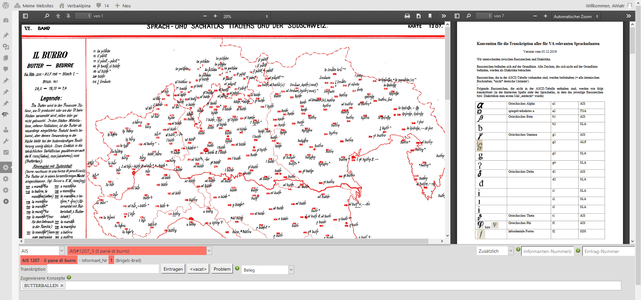
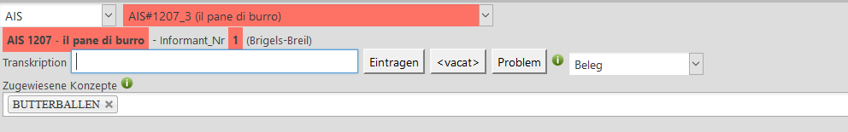
The Virtual Research Environment of VerbaAlpina and its Lexicographic Function
Lexicographic Process: Transcription Tool

Slide 13
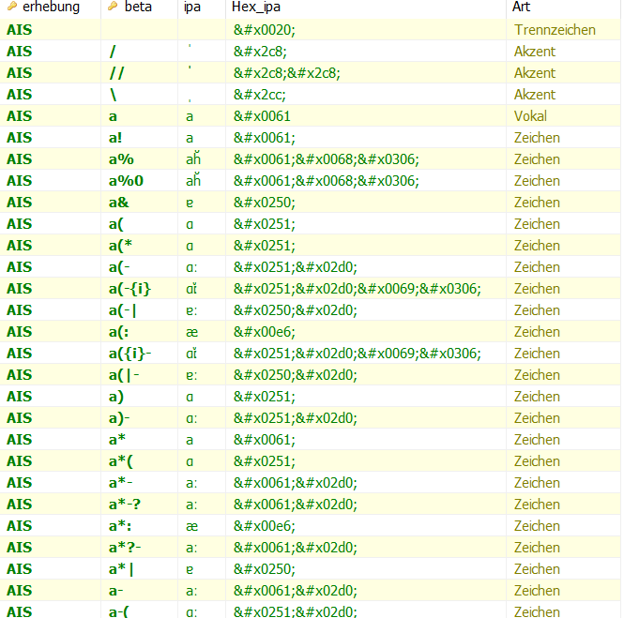
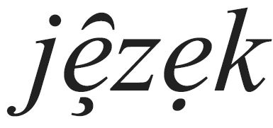

The Virtual Research Environment of VerbaAlpina and its Lexicographic Function
Lexicographic Process: Beta Code
Beta Code
Diacritics
3
4
Base sign
o?\\
1
Diacritics
2
No loss of information, all information is transcribed
Instant access to the original transcription
The system uses only ASCII signs: the data can be transcribed with any computer and by any user
For every source an unique codepage is created allowing the conversion into IPA
Notes:
VA System differentiates between basic signs and diacritics
Basic signs are all signs on baseline, Diacritics are all signs below or above the baseline

Slide 14
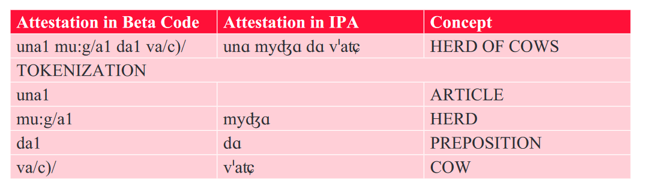
The Virtual Research Environment of VerbaAlpina and its Lexicographic Function
Lexicographic Process: Tokenization
Notes:
VA System differentiates between basic signs and diacritics
Basic signs are all signs on baseline, Diacritics are all signs below or above the baseline

Slide 15
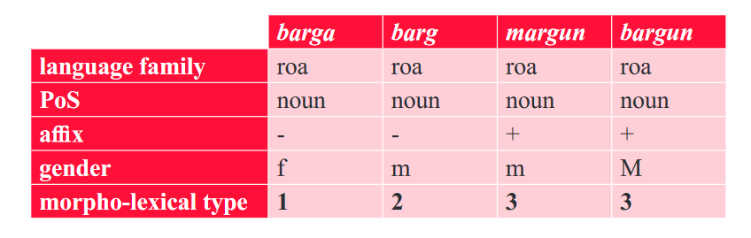
The Virtual Research Environment of VerbaAlpina and its Lexicographic Function
Lexicographic Process: Typification
Morpho-lexical type: Orthography, language family, POS, gender, affix + base type (lexical base)
*barga/*barca
Notes:
VA System differentiates between basic signs and diacritics
Basic signs are all signs on baseline, Diacritics are all signs below or above the baseline

Slide 16
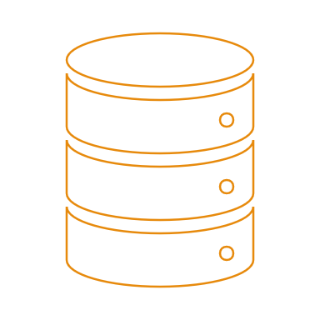
The Virtual Research Environment of VerbaAlpina and its Lexicographic Function
Lexicographic Process
Source 1
Source 2
Source n
Unified, structured and comparable data
Interactive map
SQL data base
SQL interactive map

Slide 17
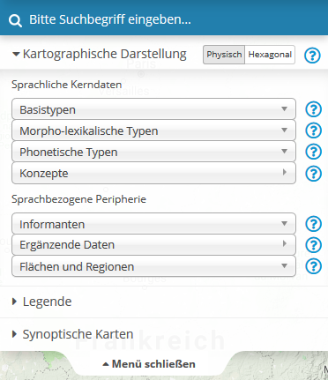
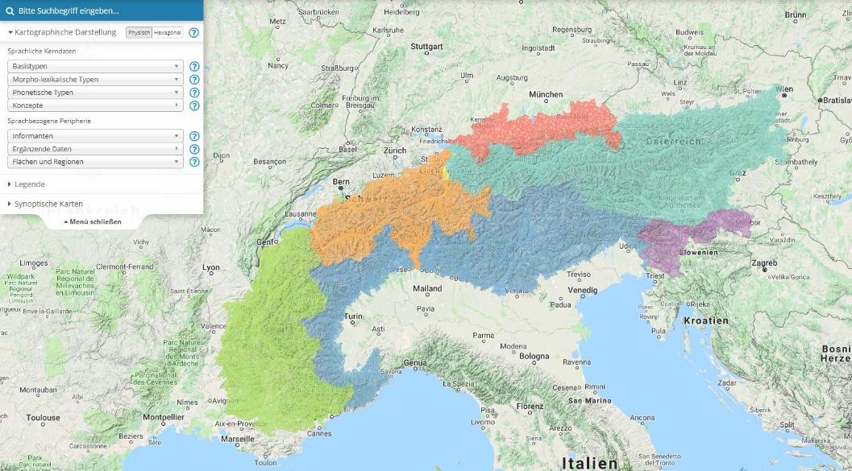
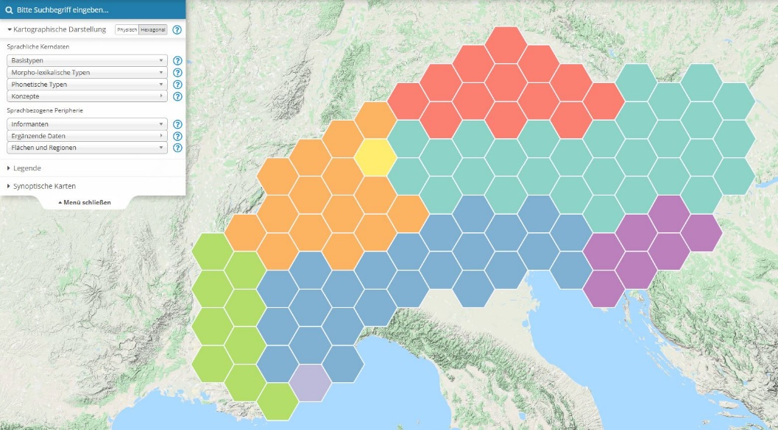
The Virtual Research Environment of VerbaAlpina and its Lexicographic Function
Data access: interactive map
Two view modes:
  Physical & hexagonal
Diverse filters:
  Onomasiologic
  Semasiologic
  Peripherical data
Tools:
  Quantifying Tool
  Synoptic maps
https://www.verba-alpina.gwi.uni-muenchen.de/?page_id=133

Slide 18
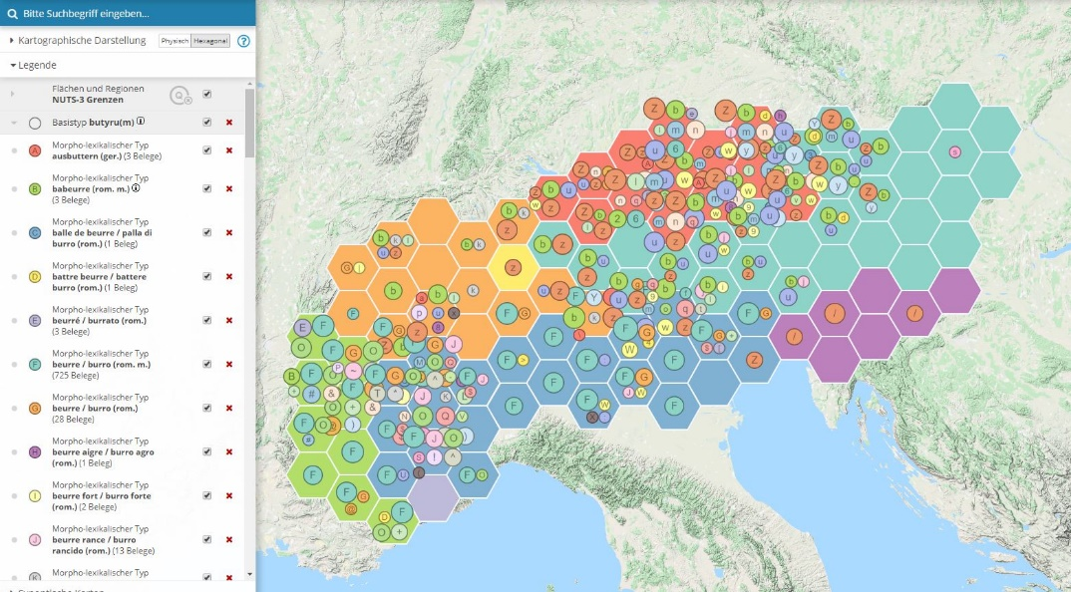
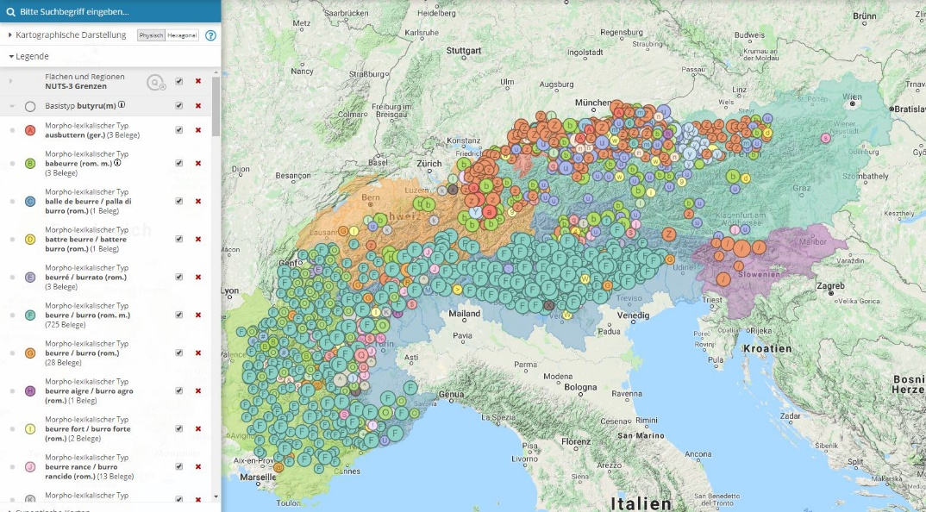
The Virtual Research Environment of VerbaAlpina and its Lexicographic Function
Base type: butyrum (lat.)

Slide 19
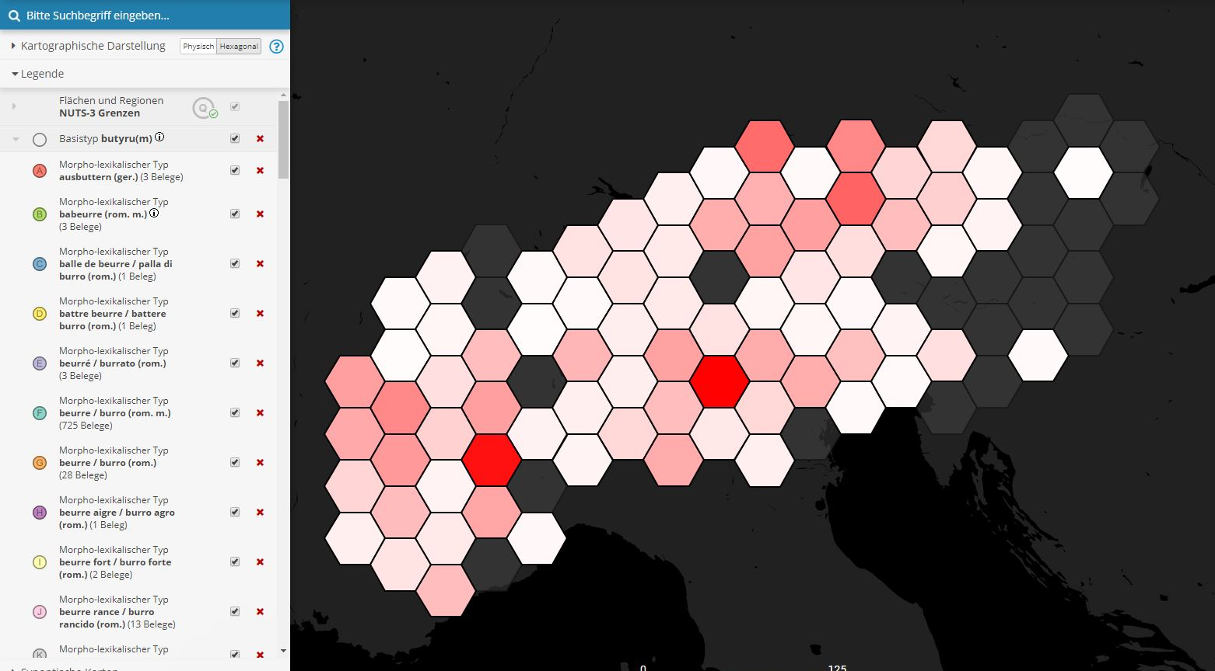
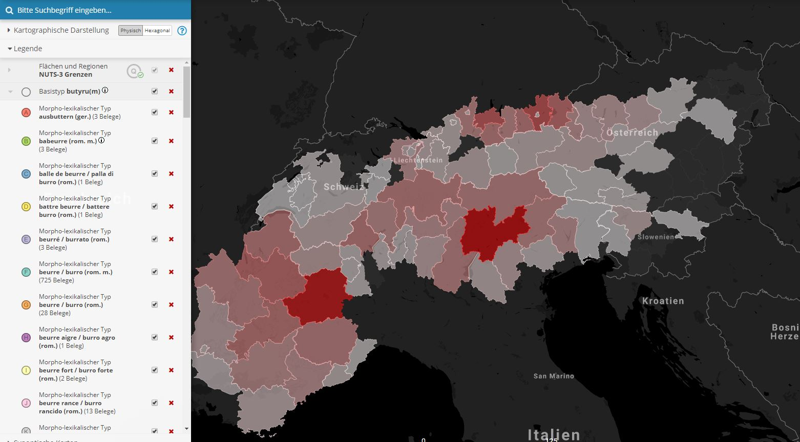
The Virtual Research Environment of VerbaAlpina and its Lexicographic Function

Slide 20
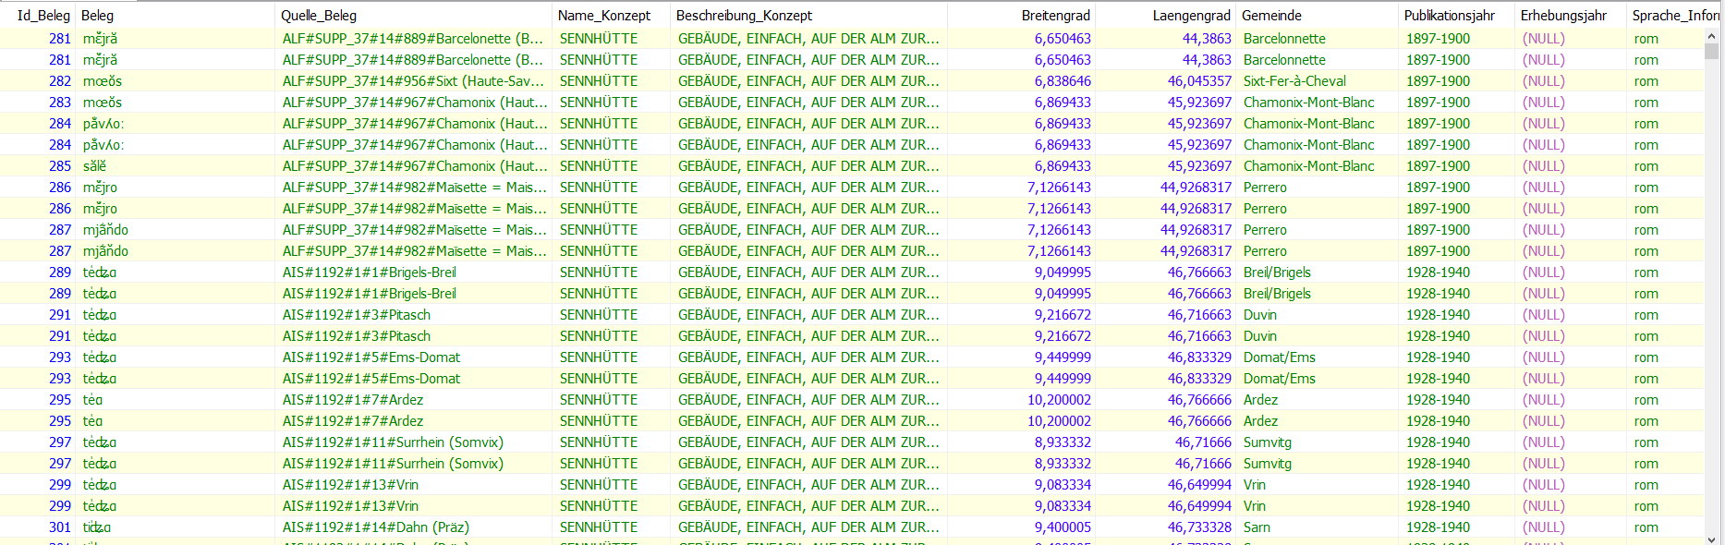
The Virtual Research Environment of VerbaAlpina and its Lexicographic Function
Data access: SQL-Queries
Direct access to the data base: structured & comparable data
Textual mode
Filtered and prepared data sets can be downloaded for further evaluation

Slide 21
The Virtual Research Environment of VerbaAlpina and its Lexicographic Function
Approaches to sustainability
            Versioning
            Citability
            long-term archiving
Notes:
- We do a lot to make VerbaAlpina and all its functionalities sustainable and long-lasting/The project takes several steps to guarantee the sustainable use of all data

Slide 22
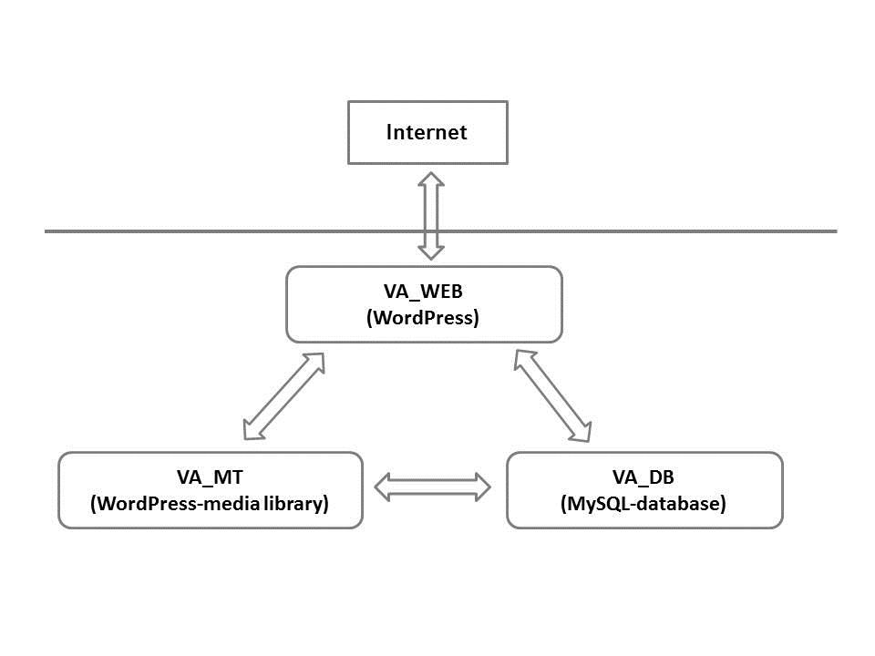
The Virtual Research Environment of VerbaAlpina and its Lexicographic Function
1) Versioning: The modules of VerbaAlpina
Notes:
VerbaAlpina consists of the following modules: VA_DB, VA_WEB, VA_MT
VA_DB: comprises the data stock which is stored in the project’s MySQL database (va_xxx)
VA_WEB: encompasses the program code of the web interface of the project platform www.verba-alpina.gwi.uni-muenchen.de including the corresponding WordPress database (va_wp).
VA_MT contains media files (photos, films, text and sound documents) which are stored in the media library of the web interface
All three modules build a consistent whole that is interrelated and interdependent → therefore they cannot be separated from each other.
During the duration of the project, the current status of the modules VA_DB and VA_WEB is “frozen” simultaneously in the form of an electronic copy every six months, on 15 June and 15 December each year. These frozen copies receive versioning numbers according to the scheme [year]/[sequence number] (e.g. 15/1). Every productive VA version is named XXX. Due to the large size of media files it is impossible to produce copies of the VA-media library (VA_MT). For that reason, no copy of this module is produced in the course of a versioning process. Media files which have been stored there once cannot be removed from the VA media library as soon as just a single VA version relates to them. On the project platform it is possible to switch between the “productive” VA version—subject to constant changes—to the archived, “frozen” versions. Appropriate colouring of the background and of certain control elements makes clear whether the productive or an archived version of VerbaAlpina is displayed

Slide 23
The Virtual Research Environment of VerbaAlpina and its Lexicographic Function
1) Versioning: The modules of VerbaAlpina
VA_DB and VA_WEB are “frozen” every six months (15/06 and 15/12)
versioning numbers for frozen copies (scheme: [year]/[sequence number], e.g. 18/1)
every productive VA version is named XXX
Possibility to switch between “productive” and “frozen” versions
Notes:
VerbaAlpina consists of the following modules: VA_DB, VA_WEB, VA_MT
VA_DB: comprises the data stock which is stored in the project’s MySQL database (va_xxx)
VA_WEB: encompasses the program code of the web interface of the project platform www.verba-alpina.gwi.uni-muenchen.de including the corresponding WordPress database (va_wp).
VA_MT contains media files (photos, films, text and sound documents) which are stored in the media library of the web interface
All three modules build a consistent whole that is interrelated and interdependent → therefore they cannot be separated from each other.
During the duration of the project, the current status of the modules VA_DB and VA_WEB is “frozen” simultaneously in the form of an electronic copy every six months, on 15 June and 15 December each year.
- These frozen copies receive versioning numbers according to the scheme [year]/[sequence number] (e.g. 15/1). Every productive VA version is named XXX. Due to the large size of media files it is impossible to produce copies of the VA-media library (VA_MT). For that reason, no copy of this module is produced in the course of a versioning process. Media files which have been stored there once cannot be removed from the VA media library as soon as just a single VA version relates to them. On the project platform it is possible to switch between the “productive” VA version—subject to constant changes—to the archived, “frozen” versions. Appropriate colouring of the background and of certain control elements makes clear whether the productive or an archived version of VerbaAlpina is displayed

Slide 24
The Virtual Research Environment of VerbaAlpina and its Lexicographic Function
2) Citability
made possible by the versioning process
date of last access is not necessary anymore (cited versions are stable)
cite in the following way:
VerbaAlpina (VA), http://www.verba-alpina.gwi.uni-muenchen.de,[version]
eg.: VerbaAlpina (VA), http://www.verba-alpina.gwi.uni-muenchen.de, 15/1
graphic contents may also be cited: individual URLs for pages and pop-up windows
Notes:
versioning process also makes it possible for the contents of VerbaAlpina to be accurately cited
unlike common online sources: date of last access is not necessary → cited versions (unlike the productive version XXX) are stable and will not be changed.
Thus, VerbaAlpina as an Internet-based digitised source becomes viable for academic writing.
As part of the bibliography VerbaAlpina can be cited in the following way:
VerbaAlpina (VA), http://www.verba-alpina.gwi.uni-muenchen.de,[version]
eg.: VerbaAlpina (VA), http://www.verba-alpina.gwi.uni-muenchen.de, 15/1
For citations of contributions that belong to the menu “methodology” on the project platform the following scheme is recommended:
[author/s]: s.v.* “[lemma]”, in: VA-[language code according to ISO 639-1] [version], methodology, [URL]
e.g.: Krefeld, T. / Lücke, S.: s.v. “Tipizzazione”, in: VA-it 15/1, Metodologia, http://www.verba-alpina.gwi.uni-muenchen.de/it/?page_id=21&letter=T#tipizzazione
The authors, marked with “auct.”, at the end of every contribution always need to be mentioned.
- graphic contents may also be cited. Every view of the interactive map can be easily shared and cited since an individual URL is produced for every page and for every pop-up window

Slide 25
The Virtual Research Environment of VerbaAlpina and its Lexicographic Function
3) Long-term archiving
Multiple copies of the project data archived by several institutions
currently: IT-Gruppe Geisteswissenschaften of Munich University (LMU Center for Digital Humanities) and archive.org
In the long term: University Library of Munich
Documentation: data structuring, logical relationships between data and data categories, character encoding
conversion from Google Maps to Leaflet is planned at the latest until the end of 2019
Notes:
plan to have multiple copies of the project data stored by several institutions
Currently: data is saved on a regular basis by the IT-Gruppe Geisteswissenschaften of Munich University (ITG, IT group of humanities) on backup servers of the Leibniz Rechenzentrum (LRZ, the Leibniz Computing Centre)
At random intervals: the module VA_WEB is also stored in the Internet Archive (https://archive.org). In addition to the automatic archiving by archive.org through their wayback crawler, VerbaAlpina also actively archives the data (since 2018 on a regular basis in the course of the versioning every six months).
We also intend to store further backup copies at other appropriate institutions like CLARIN-D
In the long term: have the archiving conducted by the University Library of Munich → project contents are accessible via the electronic catalogues
- Second: we document the data structuring, the logical relationships between data and data categories and the applied character encoding

Slide 26
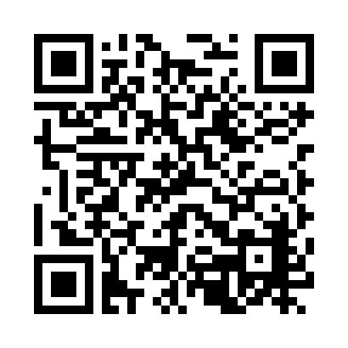
The Virtual Research Environment of VerbaAlpina and its Lexicographic Function
Thanks for your attention!

Slide 27
The Virtual Research Environment of VerbaAlpina and its Lexicographic Function
Team
Project leaders
- Prof. Dr. Thomas Krefeld (Institute of Romance Studies)
- Dr. Stephan Lücke (LMU Center for Digital Humanities)
Member of staff
- David Englmeier (computer science)
- Markus Kunzmann (German studies)
- Christina Mutter (scientific coordination, Romance studies)
- Aleksander Wiatr (Romance/Slovenian studies)
- Florian Zacherl (computer science)
- Alessia Brancatelli, Julie Defert, Monika Hausmann, Filip Hristov,
Katharina Knapp, Marina Pantele, Daniela Warras (scientific assistants)

Slide 28
The Virtual Research Environment of VerbaAlpina and its Lexicographic Function
Research Aims
Selective and analytical investigation of the linguistically and dialectally highly fragmented alpine space in its historico-cultural and historical-linguistic unity
Overcoming of the traditional limitation of geolinguistic investigation to nation-states
recognition of connections regarding the etymology of the individual dialectical words
Setting up a portal by using modern media technology: documentation, data collection, collaborative development
cooperation with other projects is fundamental for VerbaAlpina
Notes:
recognition of connections regarding the etymology of the individual dialectical words → differences and similarities between the individual language groups of the Alpine region can be found
Many words share a common etymology, even if this cannot be seen anymore at first sight: e.g. German word Butter, French beurre and Italian burro all go back to the Greco-Latin word butyru(m)
- reflected by numerous cooperation agreements with international partners from the entire Alpine region→ each cooperation is based on a formal agreement which guarantees the project partners an own database to upload their data. Each project partner’s data is available for all partners in a structured form.

