Slide 1


A (very) short introduction to the research project VerbaAlpina
Stephan Lücke
https://www.verba-alpina.gwi.uni-muenchen.de/
16 November 2021

Slide 2

Project Overview
Title: VerbaAlpina. Der alpine Kulturraum im Spiegel seiner Mehrsprachigkeit (VerbaAlpina. The Alpine cultural region reflected through its multilingualism)
Long term project funded by the German Research Foundation (DFG)
Start in 2014
Aim: Lexicographical investigation of the multilingual Alpine region
Cooperation of (geo-)linguistics and Digital Humanities (DH)
Project leaders: Thomas Krefeld (Linguistics), Stephan Lücke (DH)
Staff: 2 (3 until 2020) linguists, 2 computer scientists, aides/assistents

Slide 3
Project phases
NOW
project years
1 | 2 | 3 | 4 | 5 | 6 | 7 | 8 | 9
calendar year
2014 | 2015 | 2016 | 2017 | 2018 | 2019 | 2020 | 2021 | 2022 | 2023
i, ii, iii, iv | i, ii, iii, iv | i, ii, iii, iv | i, ii, iii, iv | i, ii, iii, iv | i, ii, iii, iv | i, ii, iii, iv | i, ii, iii, iv | i, ii, iii, iv | i, ii, iii, iv
quarter
project phase
I | II | III
culture milk processing | nature landscape formations weather fauna flora | modern life ecology tourism
focus
alpine pasture farming
1st term: 10/2014-10/2017, 2nd term: 11/2017-10/2020, 3rd term: 11/2020-10/2023 (perspective until 2025)

Slide 4
What VerbaAlpina does or is …
Collection of lexemes denoting selected concepts typical for the Alpine region
Example: What words are used to denote „BUTTER“ in different regions of the Alps (Butter, beurre, burro, Anke …)
Focus on dialects (not national/standard languages)
Speech atlas and dictionary in one (traditionally impossible)
Central feature: Publication of data on high-performance online map (WebGL)
Commitment to Open Science (compliance with FAIR principles)
Fully digital (no use of paper at all): multifunctional web portal (WordPress; Backend: MySQL database)
Method reflection (section „Methodologie“; profit and challenges of DH)

Slide 5
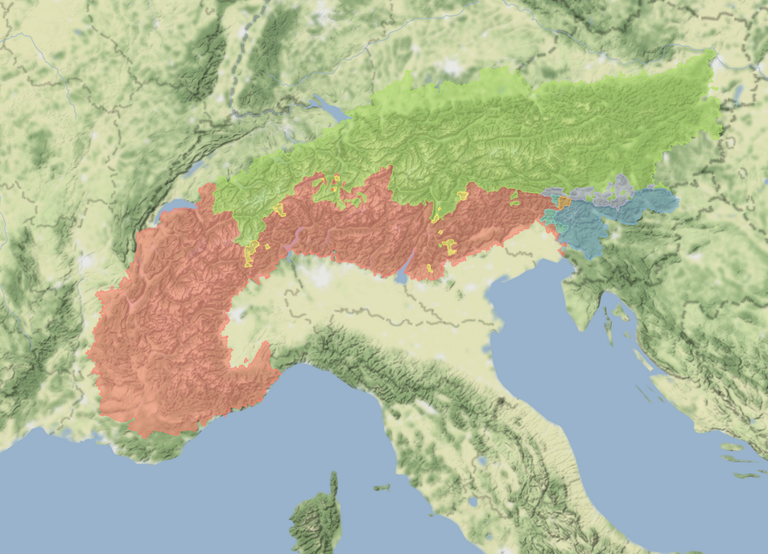
Area under investigation
Area of investigation is limited to the territorial borders defined by the
Alpine convention
surface area of 190,600 km²,
encompasses parts of six different
countries (D, A, CH, I, F, SLO) and
two entire countries (FL, MC)
with 5771 municipalities
ethnographic and topographic
homogeneity and strong linguistic
heterogeneity → 3 language families
Germanic
Slavonic
Romance

Slide 6
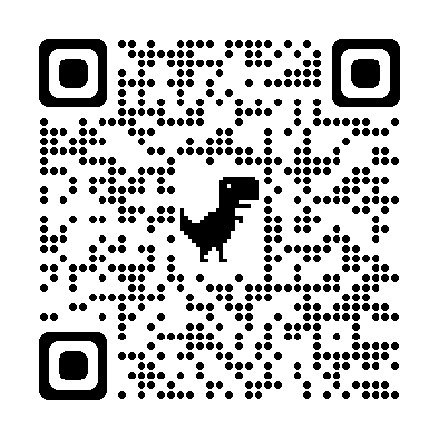
Where our data come from …
Multiple different sources:
printed atlases/dictionaries (georeferenced)
digital material from project partners
crowdsourcing

Slide 7
You`re welcome to get in touch with me:
luecke@lmu.de

Slide 8
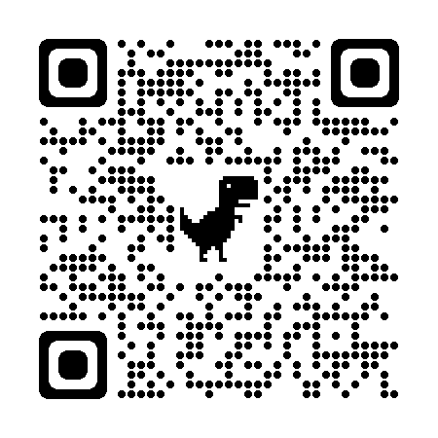
https://www.verba-alpina.gwi.uni-muenchen.de/

